Slide 1

CSR Projects in PCMC Area
by
ARaymond India Private Limited

Slide 2
ARaymond India Private Limited

Slide 3
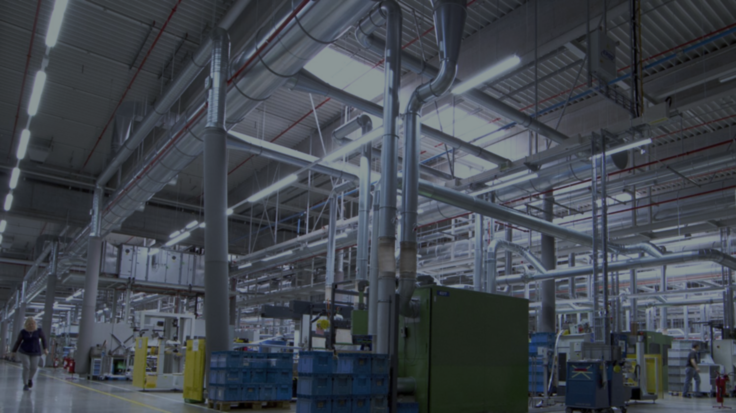







About ARaymond
8 000+
employees
€1.5 bn
2025 sales revenue
INTERNATIONAL EXPERT
IN ASSEMBLY, FASTENING
& FLUID HANDLING SYSTEMS
28
manufacturing sites
25
countries
1865
Established in 1865
100 % family-owned company
2 500
active patents
6%
of turnover
invested in R&D

Slide 4
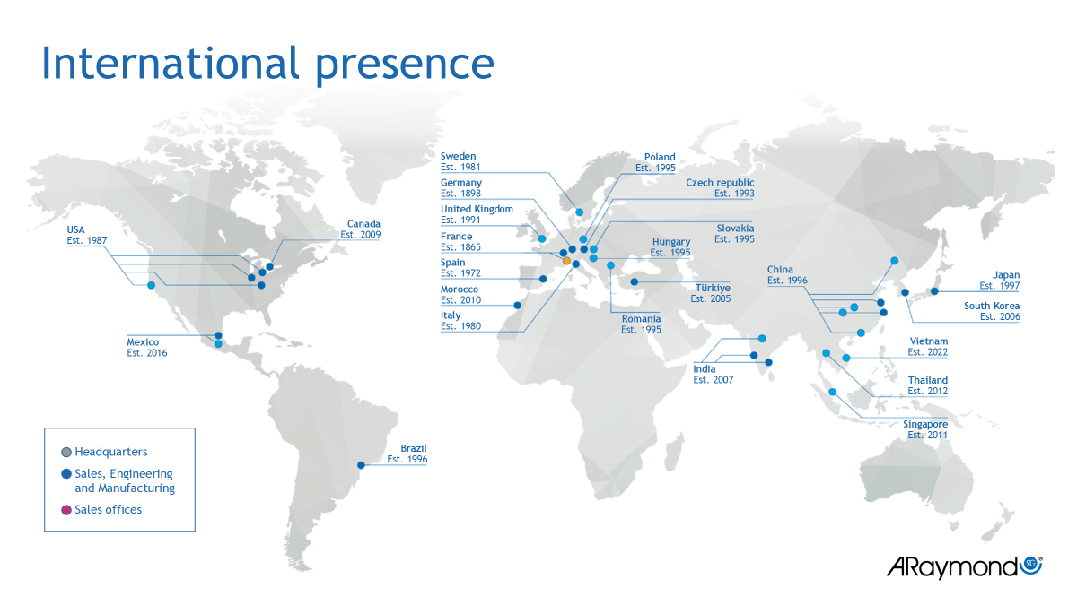

Slide 5


OUR CSR APPROACH
IS BASED ON 5 KEY PILLARS
Corporate Social Responsibility
OUR PLANET
OUR SOCIETIES
OUR PEOPLE OUR BEHAVIOR
OUR VALUE CHAIN

Slide 6
Power of Hockey- Holistic development of Underprivileged children through the Power of Hockey
The Hockey Project is a grassroot initiative designed to empower underprivileged children through sports. It provides Financial Assistance for sports equipment, and coaching, access to tournaments, skill building workshops, mentorships programs, and exposure visits.
The Project on Holistic development by strengthening Physical, health, nutrition cognitive abilities, emotional intelligence, social skills, confidence, self-esteem, discipline, teamwork, ethics, and resilience. The Initiative envisages training 500 schools’ children aged 10 to 14 years, including both boys and girls, over a three-year period. From 2023 to 2026
Total budget 6,546,000.00 (Sixty-five Lac Forty-six thousand)

Slide 7
Power of Hockey- Holistic development of Underprivileged children through the Power of Hockey
Project Goal
To provide opportunities for children to develop social, educational, and athletic skills (with a particular emphasis on girls) for their holistic development leading to Quality Life.
Objectives
Train 500 children (boys and girls aged 10 – 14 years) in hockey sports.
To conduct awareness sessions with the parents for holistic child development.
To ensure the Quality of Life of 500 children.

Slide 8
Timetable of Hockey Practice - 7 Schools
School Name | Day | Time | Coach
1. Anand Vidyaniketan High School, Viman Nagar, Pune 411014 | Thursday & Saturday | 07:00 AM o 11:00 AM | Rushabh Aspat
2. Janata High School, Vishrantwadi, Pune 411015 | Wednesday & Saturday | 2:00 PM to 6:00 PM | Pranali Patil
3. Shri Sant Tukaram high School, Lohgaon, Pune 411047 | Tuesday & Friday | 8:00 Am To 12:00 PM | Amit Dhere
4. Lokmanya Tilak High School, Khadaki, Pune 411003 | Tuesday & Sunday | 08:00 AM to 12:00 PM | Amit Dhere
5. Ramchandra gaikwad high school Dighi, Pune 411015 | Tuesday & Saturday | 12:00 AM to 4:00 PM | Devidas More
6. Eknathrao Khese high school Lohgaon, Pune 411047 | Monday & Thursday | 12:00 AM to 4:00 PM | Abdul Salmani
7. Shri Sayajinath Maharaj high School Charohli, Pune 412105 | Tuesday & Saturday | 12:00 AM to 4:00 PM | Rehan Shaikh

Slide 10
Support for ultrasound sonography machine at Yamunanagar PCMC Hospital (Yamunanagar Municipal Maternity Hospital) FY 2023-24
* A major slum area predominantly inhabited by daily wage earners. Daily footfall of around 80 female patients.
* The Hospital was facing critical gap due to the absence of an ultrasound machine. As a result, pregnant women were compelled to seek sonography services from Private Hospitals, incurring of an expenses of approximately Rs. 2000.00 per visit.
* Typically, a women requires 4-5 ultrasound scan during pregnancy to monitor the development and well being of the fetus, making it a significant Financial burden.
* This initiative is expected to benefit around 1000 women and newborns annually from economically disadvantaged backgrounds, ensuring improved access to timely and affordable maternal Healthcare.
Total Budget = 1750000.00 (Seventeen Lac Fifty Thousand only)

Slide 11
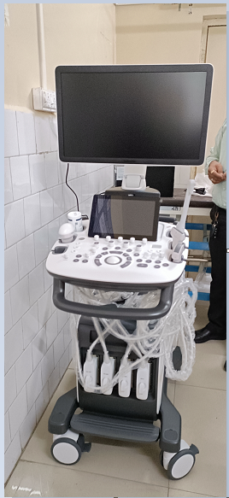
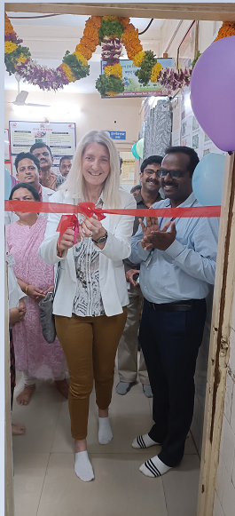
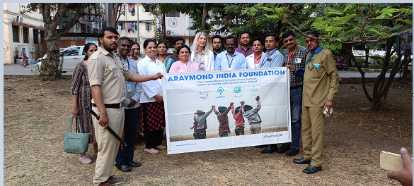

Slide 12
Ophthalmology Operation Theater and OPD Department – New Thergaon PCMC Hospital, Pune
2024-25
ARaymond India supported the hospital to start with Ophthalmology department by providing all the high-end necessary equipment's and technology.
This help will cater to 12000 citizens in a year especially elderly citizen.
Total Budget 27,97,271.00

Slide 13
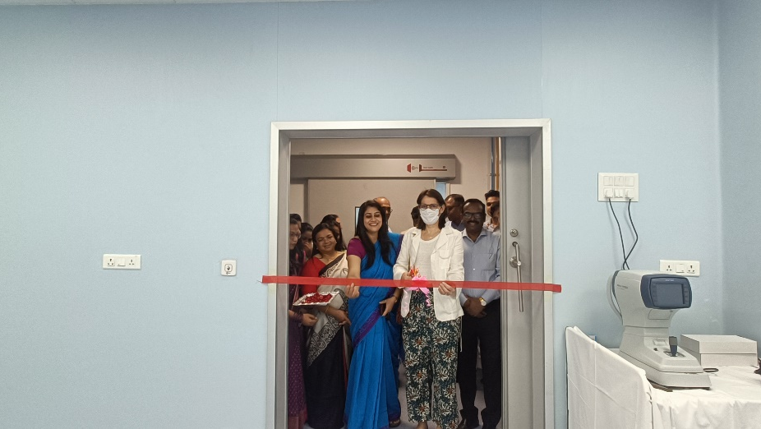
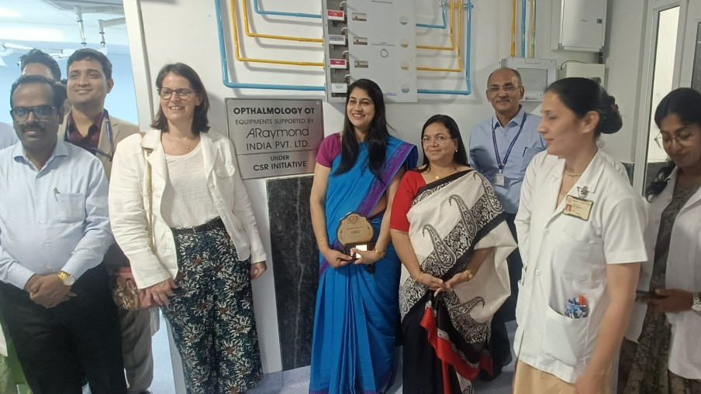
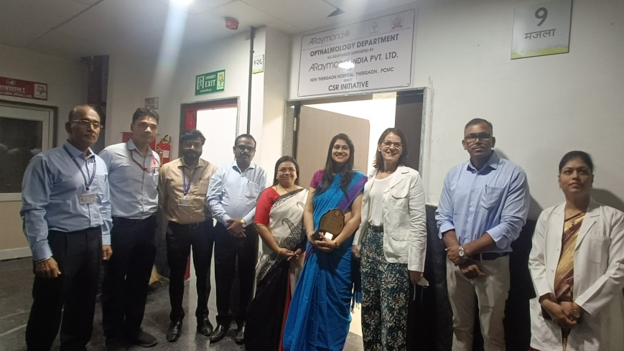
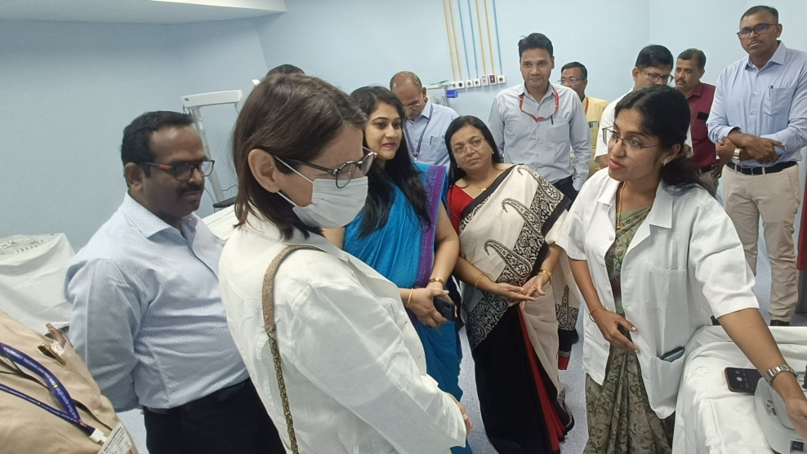

Slide 14
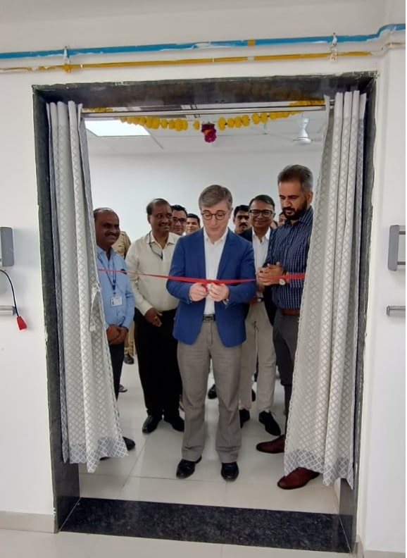
Support of 2 Dialysis units at Prabhakarrao Malhar Kute memorial Hospital, Akurdi (PCMC) 2024-25
Araymond India Extended its support to the Prabhakarrao Kute Memorial Hospital, Akurdi (PCMC) by providing 2 Dialysis units under its CSR Initiatives.
This intervention is currently benefitting over 100 patients on monthly basis.
Total Budget = Dialysis Machine= 1240000.00 and RO Plant 500Litre PH= 180000.00 = 14,20,000

Slide 15
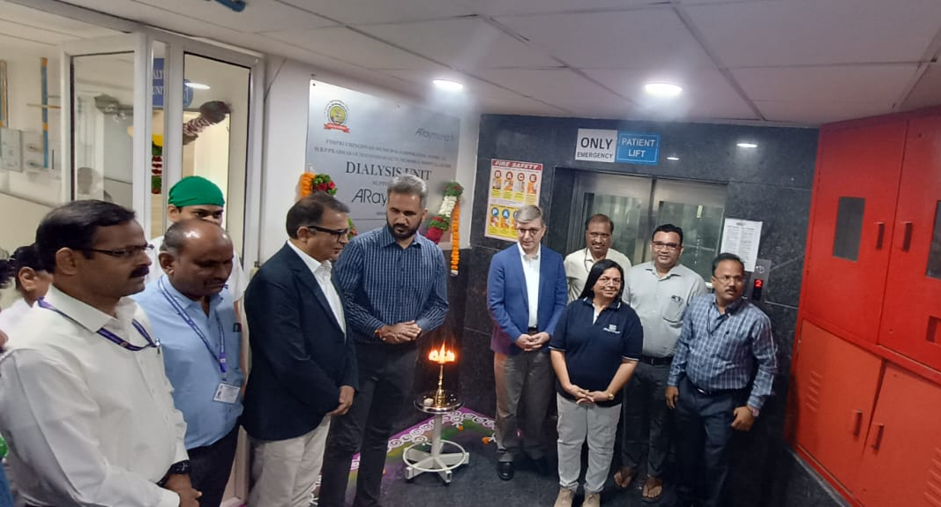
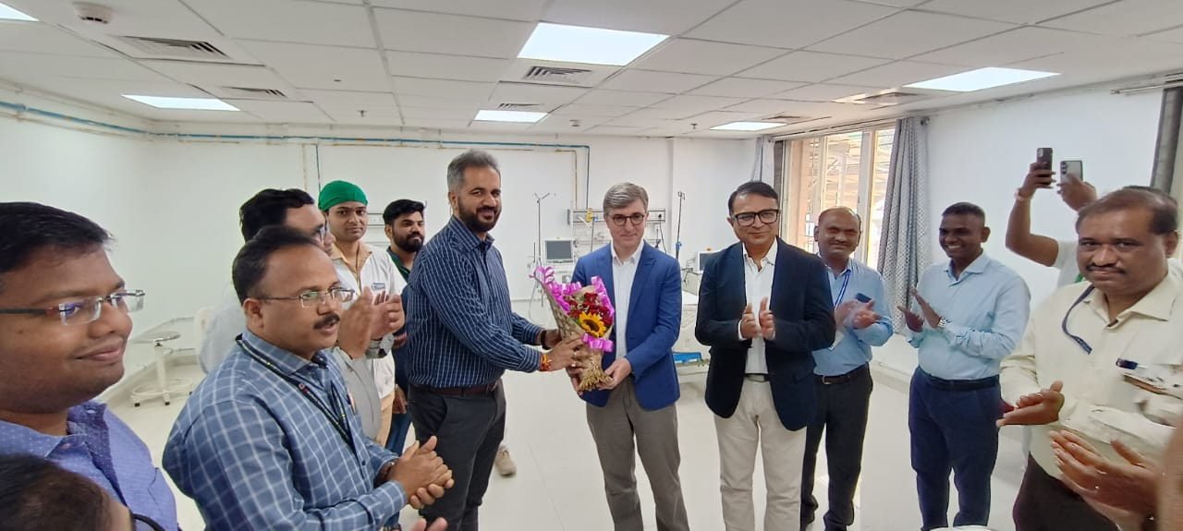
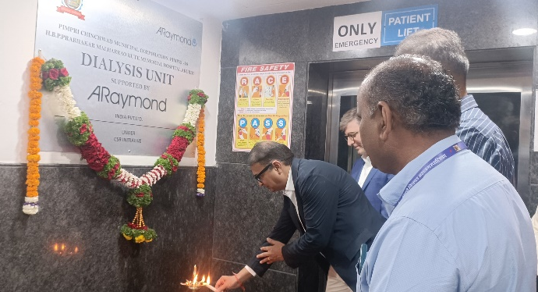
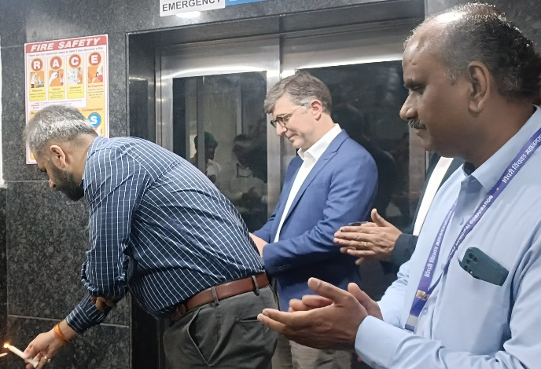
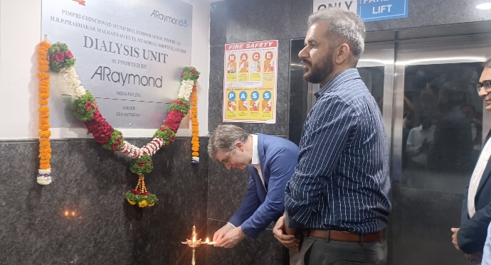

Slide 16
ARaymond India Private Limited supported New Thergaon PCMC Hospital equipment's as mentioned below- (Upcoming project)
Motorized OT Table (Ophthalmology ) Fully stainless-steel medical Grade SS With stools Quantity
Phaco emulsification system with peristaltic pump (Medisonix make, Model CHAXUCX3)with GST Quantity
Cataract surgical instrument (1 to 19 items) quantity
CFlow 9 anesthesia workstation with modes PCV, VCV, VCV-SIMV, PSV. ,Manual ventilation ACGO mod with single vaporizer with 3 years warranty with GST Quantity
Ventilator Cvent- 1000 adult pediatric with 3 years warranty with GST Quantity
Ishihara colour vision chart 2
Defibrilator philips Efficia DFM 100 Defibrillator / Monitor
Total Cost 40Lac.

Slide 17
Thank You

